Slide 1


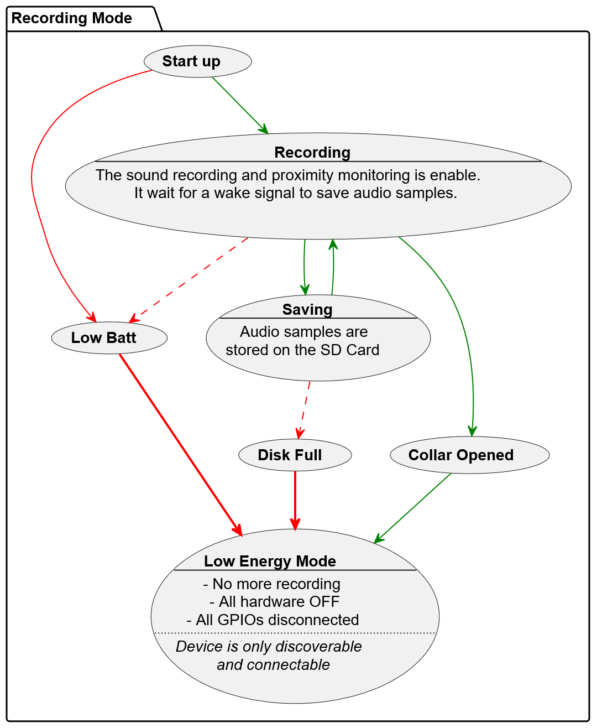
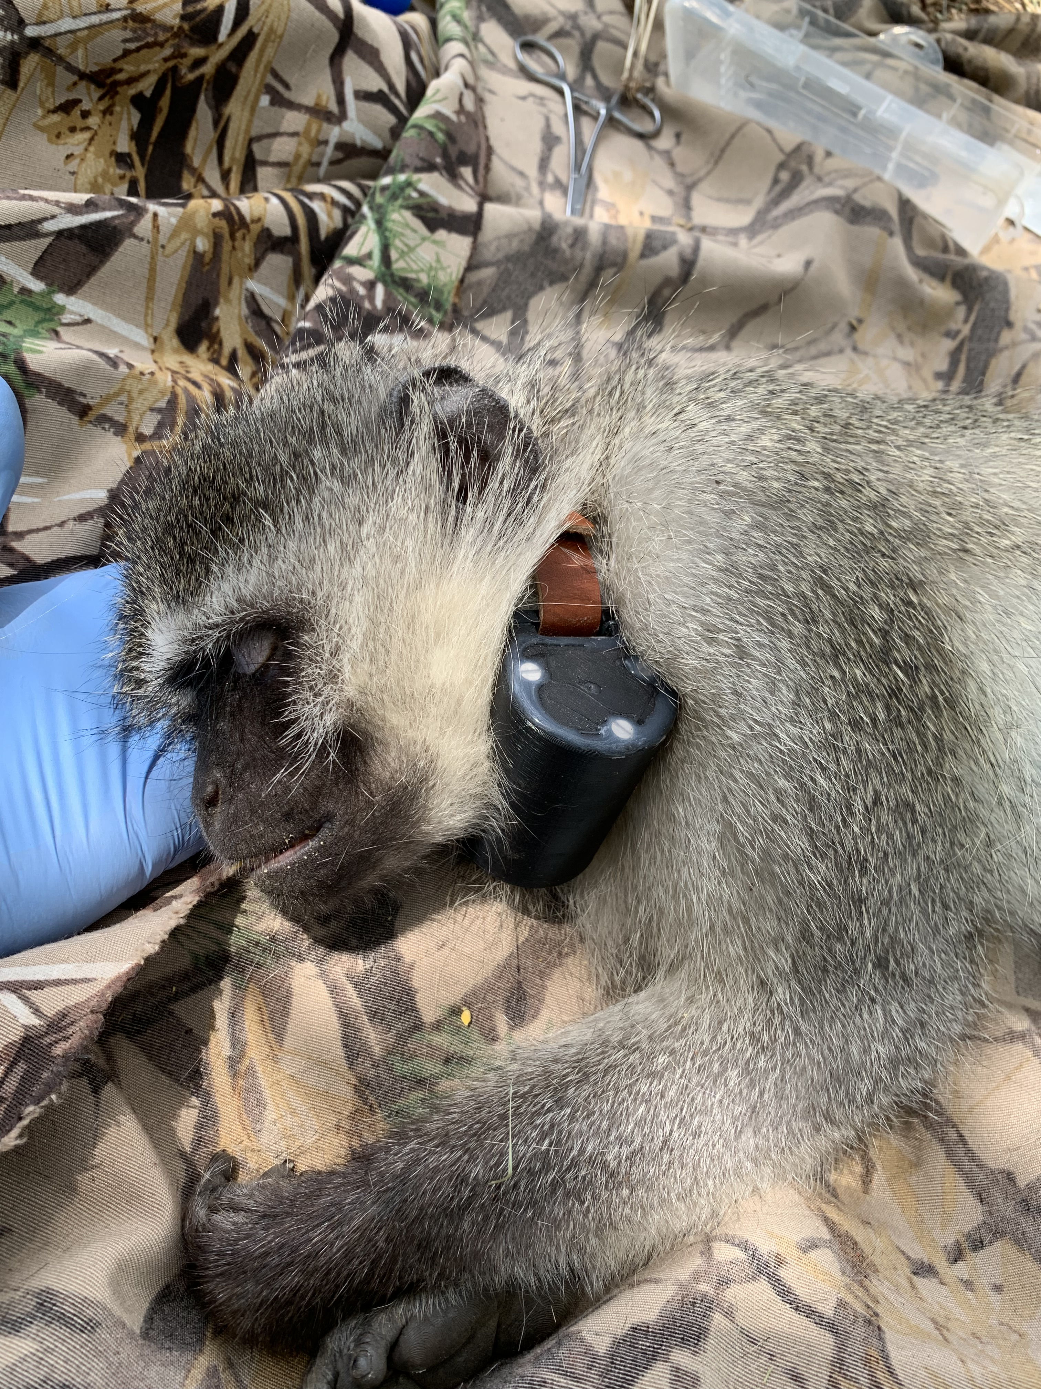
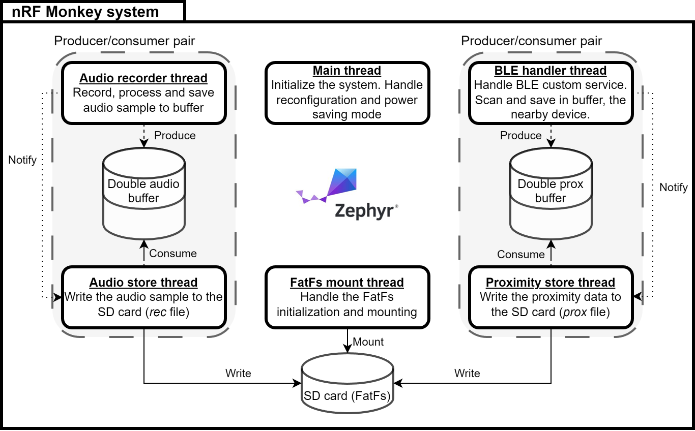
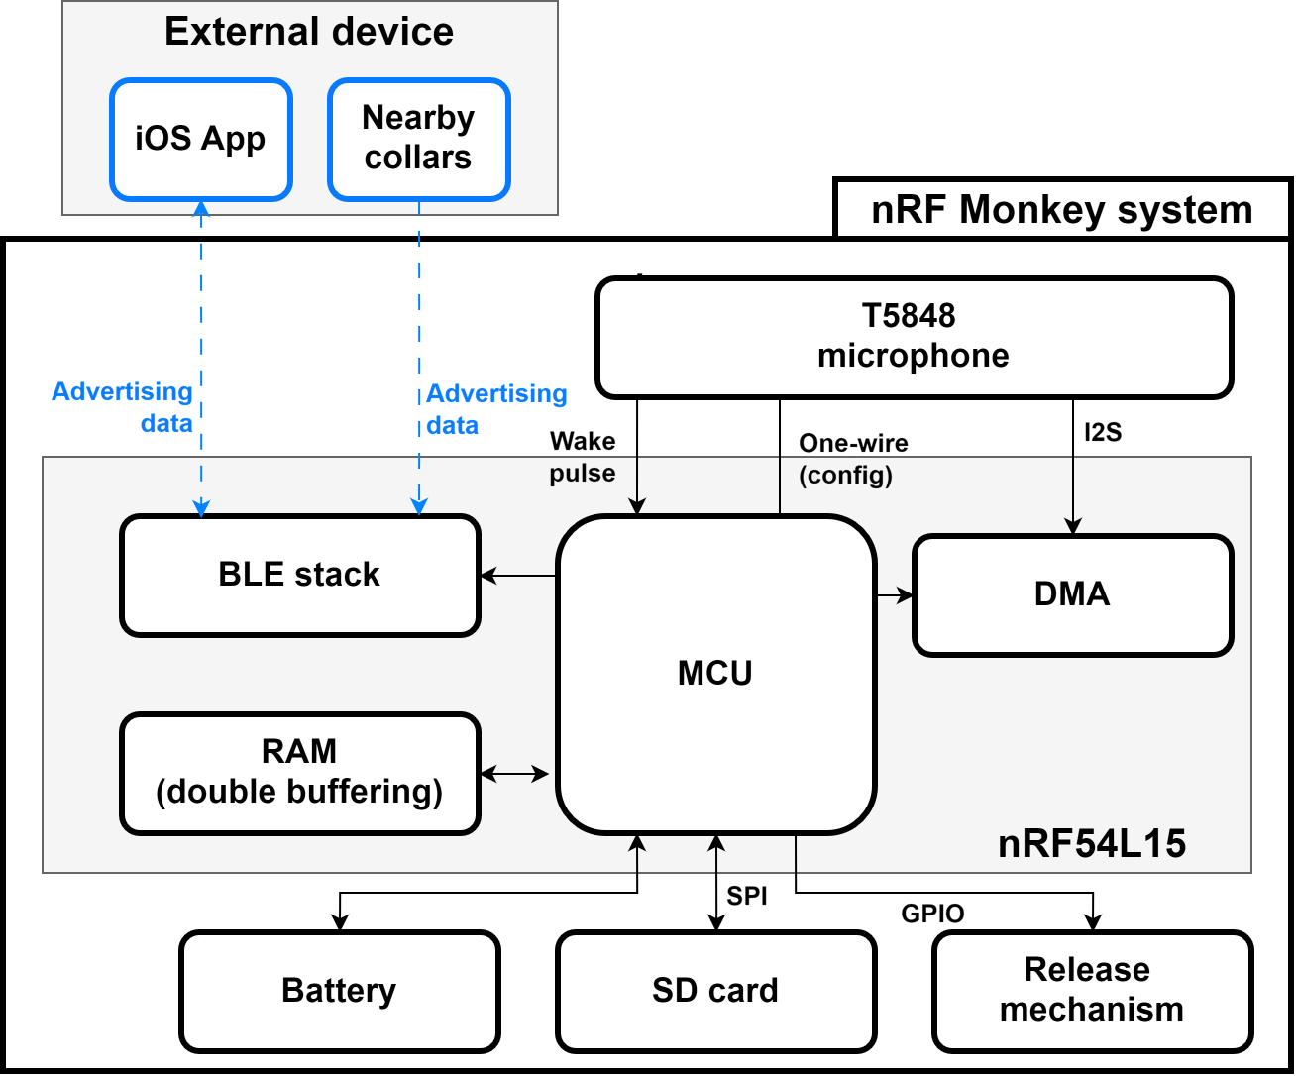







DATA COLLAR
Adrien Rey
Master of Science HES-SO in Engineering
Major in Embbeded systems
Under the supervision of Alexandra Andersson
INTRODUCTION
SYSTEM USE CASE DIAGRAM
Context
Studying primate behavior in their natural environment is key to understanding how they live and interact. Direct observation is difficult and often affected by the surroundings. The nRF Monkey data collar, develop by the ECS research group at HES-SO Valais/Wallis, aims to monitor Vervet monkeys in South Africa to analyze their vocal communication and social structure. The collar can record for 12 days straight and then be released using a mobile app.
Fig. 1 - nRF Monkey collar
Problem
The first prototype recorded audio continuously, leading to critical issues:
High power consumption : Battery life limited.
Data overload : more than 90% of garbage recording, leading to a 12 days autonomy to its full memory.
Lack of context : No data on social interaction between individuals.
Objectives
Develop a V2 prototype focusing on energy efficiency and smart features :
Hardware update (microcontroller + microphone)
Firmware update
Intelligent audio level triggering
Monkey proximity detection via BLE
Power consumption optimization
Fig. 3 - nRF Monkey use case diagram
FIRMWARE ARCHITECTURE
SYSTEM OVERVIEW
Fig. 3 - nRF Monkey firmware architecture
RESULTS & CONCLUSIONS
Feature | V1 | V2 | Improvement
Standby current | 4.01mA | 0.39mA | ~10x reduction
Saving current | 4.01mA | 2.13mA | ~2x reduction
Battery life | 26days | 200days | ~7.5x augmentation
Social Context | None | BLE prox. | New social mapping feature
The V2 prototype implements an intelligent architecture that achieves a consequent increase in autonomy. By combining sound triggering with BLE proximity detection, it provides an efficient and reliable platform for primate behavioral research.
Fig. 2 - nRF Monkey system overview
Notes:
Le poster est une obligation pour tous les TM (confidentiels ou non). Il s’agit d’un document public destiné à la communication et donc les aspects confidentiels ne doivent pas figurer. La mise en forme reste assez libre, un arrière plan peut être ajouté, l’utilisation 1-2-3 colonnes, la mise en place de séparateur, cadre, etc. est laissée au libre choix de l’étudiant-e

